Slide 1
Efficient Onboarding
Accelerating New Engineer Productivity

Slide 2

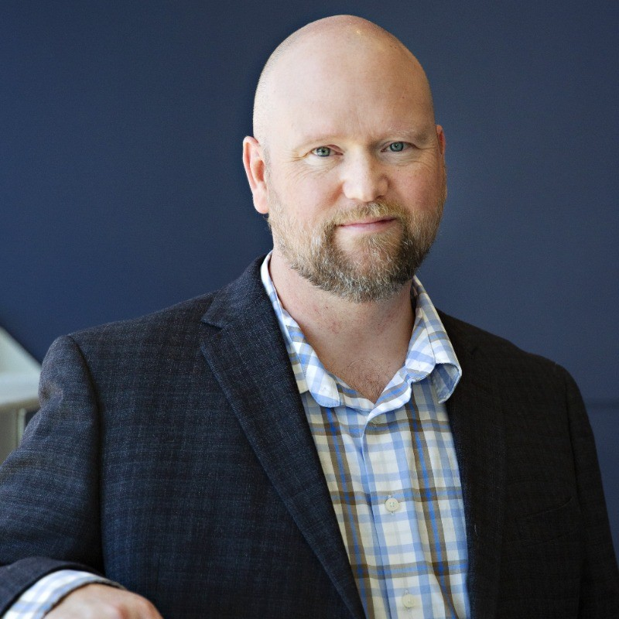
Russ Harding
Vice President of Engineering EQengineered.com

Slide 3
01
02
03
The Problem
The Cost of Manual Setup
The Goal
Manual onboarding slows productivity
Senior engineers pulled away to help new hires
Environment drift between team members
Time: 1–3 days average setup
Errors: inconsistent dependencies
Burnout: seniors become “setup support”
Friction: slow start = low early morale
Setup in <1 hour
Reproducible across all machines
Self-service for new hires
Consistent environments for the whole team

Slide 4
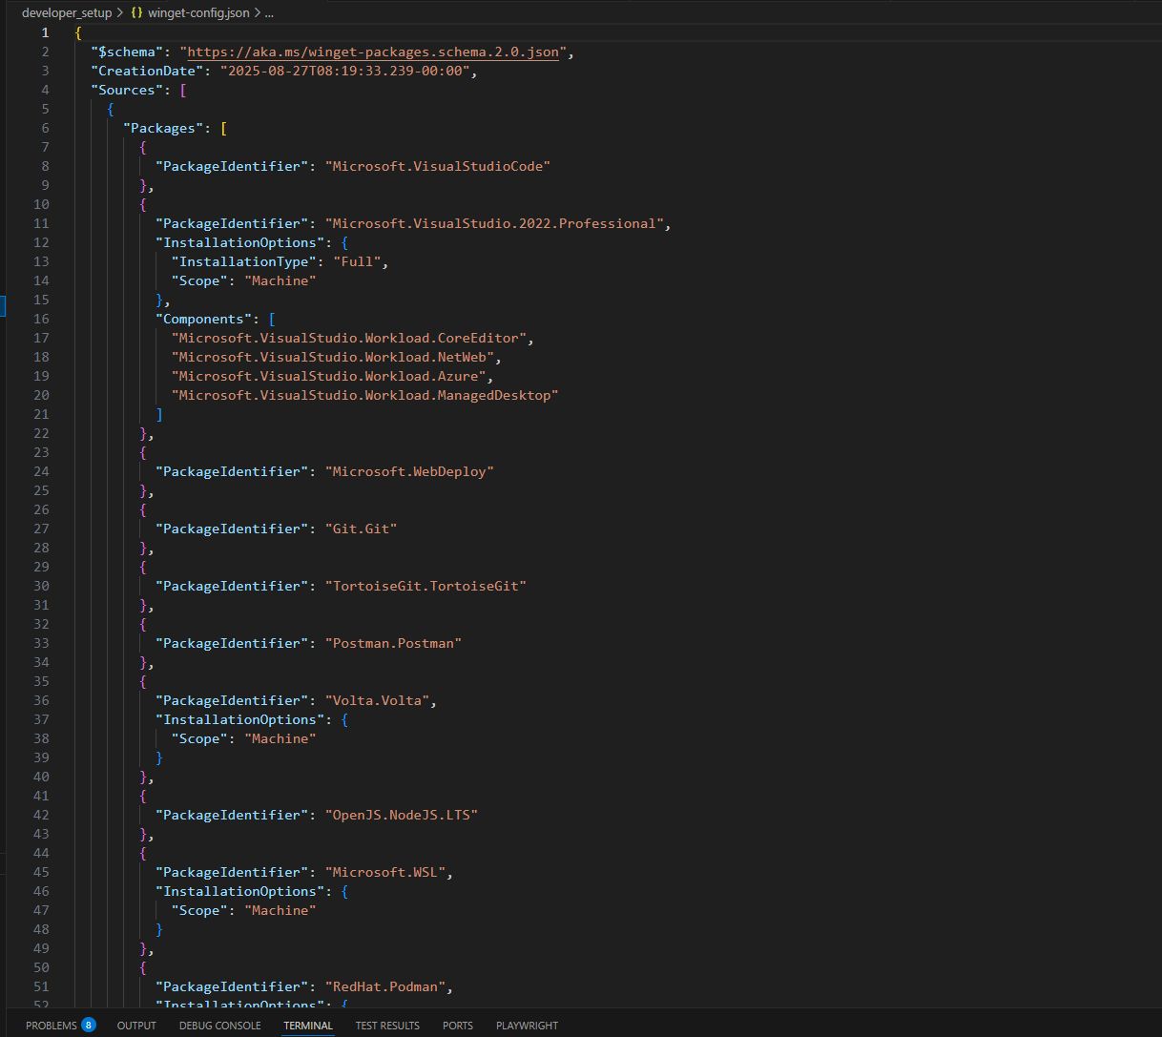
Winget Configuration
From click-through installers to one command
Benefits: repeatable, version-pinned, scriptable

Slide 5
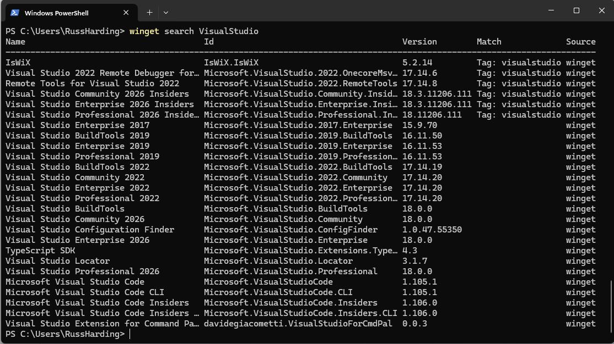
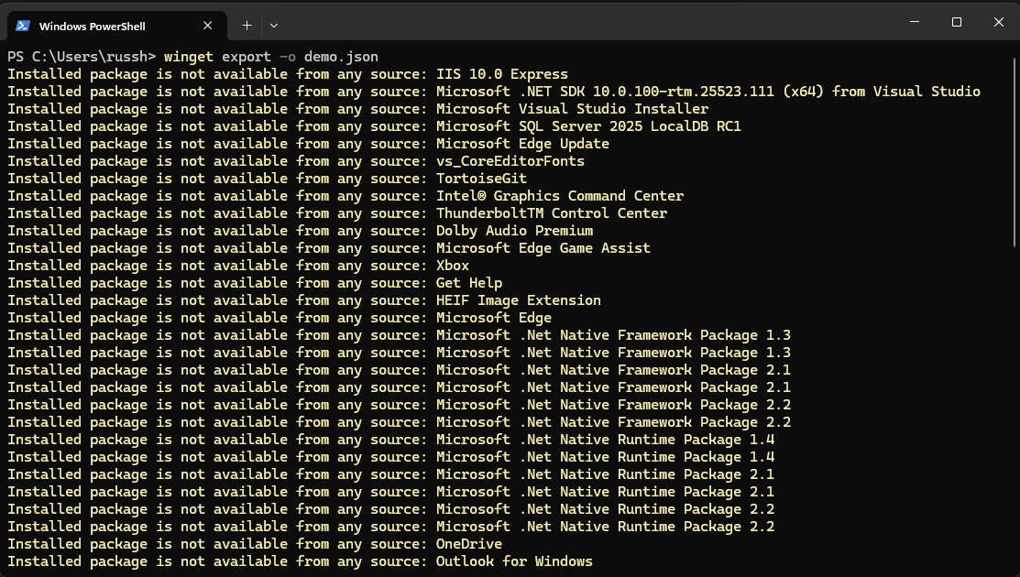
WinGet for Managing Software
Simplifies software installation, updates, and removal with consistent command-line tooling.
Supports automated deployment and repeatable setups using scripts and manifests.
Integrates with the Microsoft ecosystem for trusted, secure package sourcing.
Alternatives for macOS
Homebrew – the most widely used macOS package manager, offering apps, command-line tools, and casks.
MacPorts – another package manager focused on reproducible builds and isolated environments.

Slide 6
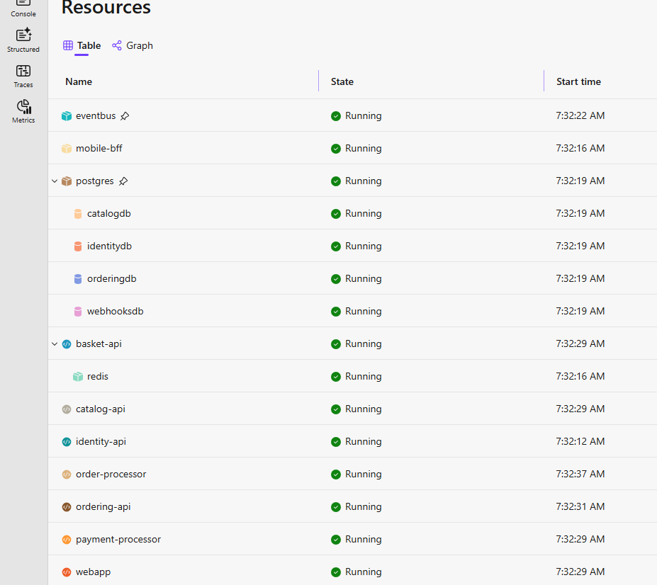
Aspire
Provides an opinionated, cloud-ready application model that simplifies building distributed systems.
Includes built-in orchestration, observability, and configuration tooling for local development and cloud deployment.
Streamlines integration with popular services (Redis, PostgreSQL, Dapr, etc.) using standardized components.
Still provides strong local orchestration, configuration, and observability; no cloud required.
Let’s teams standardize service dependencies (Redis, PostgreSQL, messaging, etc.) even when self-hosting.
Eases future cloud migration by using cloud-ready patterns from day one, while running fully on-prem today.
Learn more at aspire.dev

Slide 7
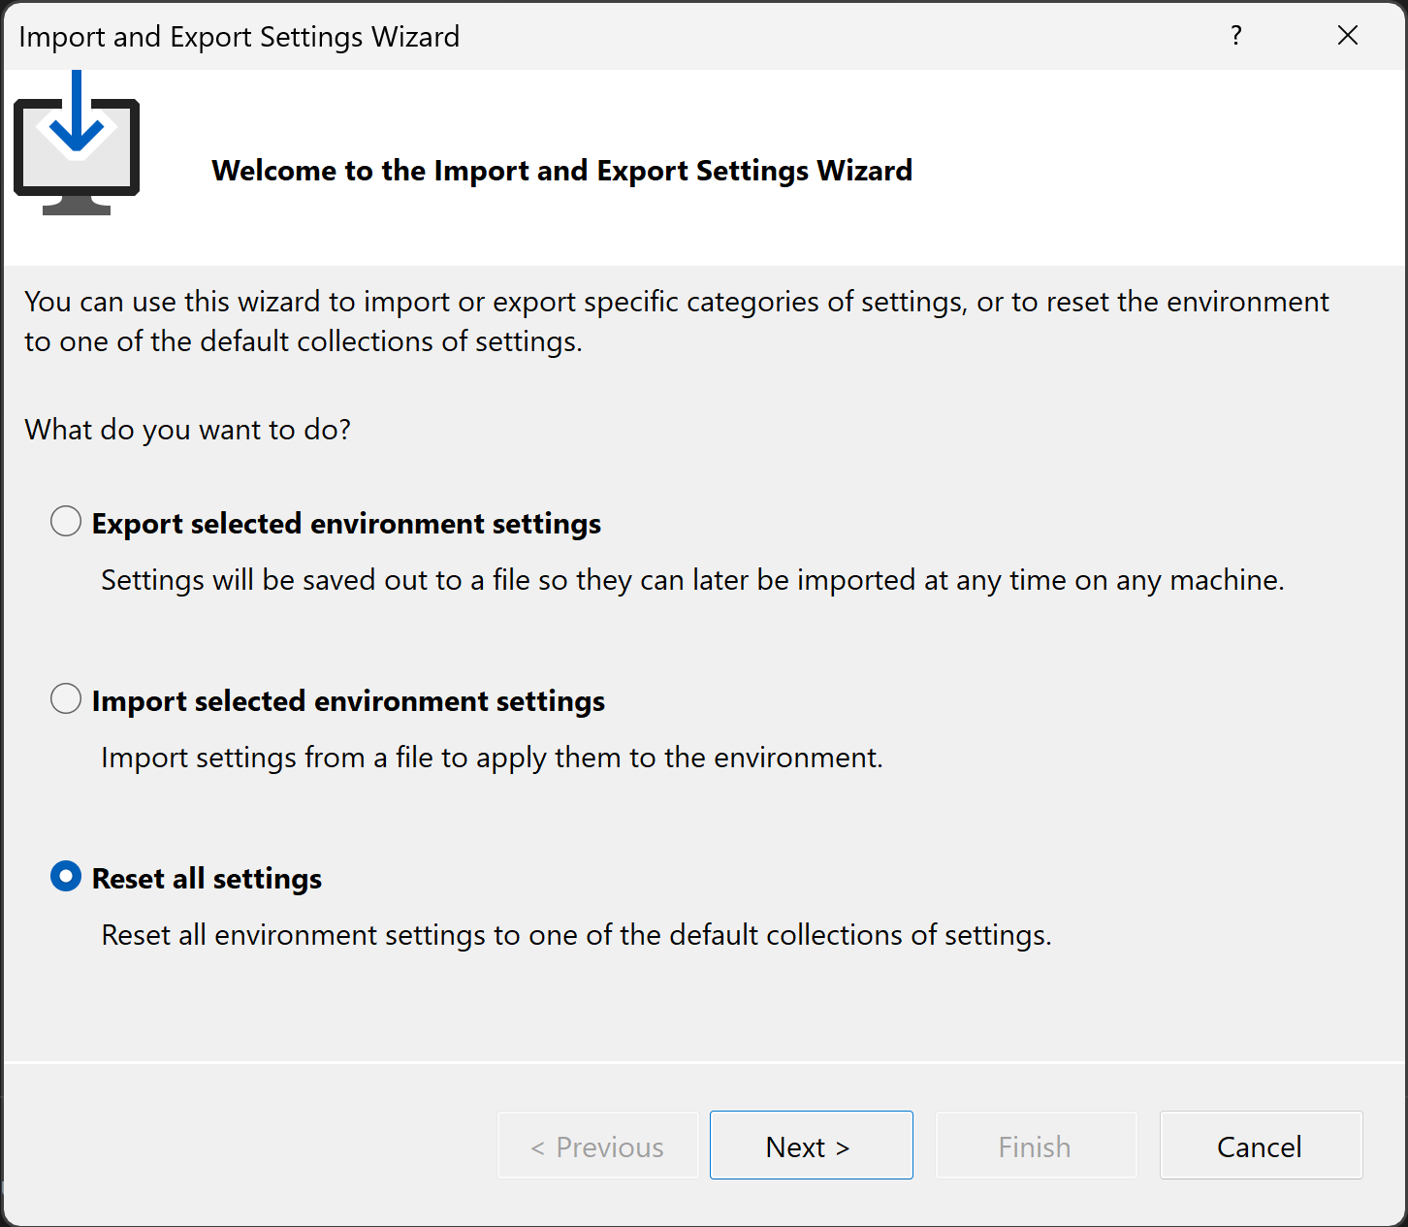
Standardize Visual Studio IDE Settings
Export your current Visual Studio environment (themes, key-shortcuts, layouts, templates) → .vssettings file.
Import that .vssettings file on a new machine: Tools → Import and Export Settings → Import.
Reset to default if needed: Tools → Import & Export Settings → Reset all settings.
Customize once: themes, fonts & colours, menus/toolbars, window layouts.
Store the settings file in a shared repo so every new hire gets the exact same IDE experience out-of-the-box.

Slide 8
Empowering teams to go from setup to deployment in minutes.

Slide 9
Russ Harding
Vice President of Engineering EQengineered.com

Slide 10
Thank you

